Slide 1

NLP – Natural Linguistic Programming
DATASET- RETAIL REVIEWS
STORY-TELLING
By- Saurabh Sharma, 190041, BMU

Slide 2
OUTLINE :
This is a Women’s Clothing E-Commerce dataset revolving around the reviews written by customers. Its eleven supportive features offer a great environment to parse out the text through its multiple dimensions.
I use various methods and try to predict the customer sentiment from reviews. As you can guess, there are various methods to succeed this and each method has pros and cons. I think Naive Bayes is one of the most important methods in text mining because it is the fastest. However, if we do not have a very large dataset or have high CPU power, the others might be useful too.
Here, I started with examining the data and use some charts to reach more insights. Afterwards, I applied different models and compared them from various aspects.
Total reviews collect on the basis of 11 features are 19662. That means a total of 19662 records were gathered which is now analysed using NLP mechanisms

Slide 3
CLEANING AND PREPROCESSING
In order to make some analysis, we need to set our environment up. To do this, I firstly imported some modules and read the data.
In the cleaning process I dropped some columns which I feel Is not important and some rows has missing values shown as NAN which I removed.
Further, I decided that I do not need some columns and defined a new dataset which just has the columns I used.
The new dataset which I created has the following columns on which further analysis is done
Review Text
Rating
Class
Name
Age
Adding the word counts to a data frame is a very good practice because we might use these counts to reach some useful information. To do this, I defined the function wordcounts.

Slide 4
Demonstrating the Densities of Class Names, Some Selected Words and All Words in the Reviews By Using WordCloud
In this section, I demonstrated the word densities which can be very informative. First, I selected some words which show the customer sentiments like love, hate, fantastic or regret. Second, since we do not know the product names, I decided to check the product class names. By doing this, we may at least learn the most preferred classes.
Further, I thought that looking at the densities of all words in the reviews might be interesting. Lastly, I used the Word Cloud module and printed the first five lines of the tables which shows the word counts for the selected words and the class names.

Slide 5
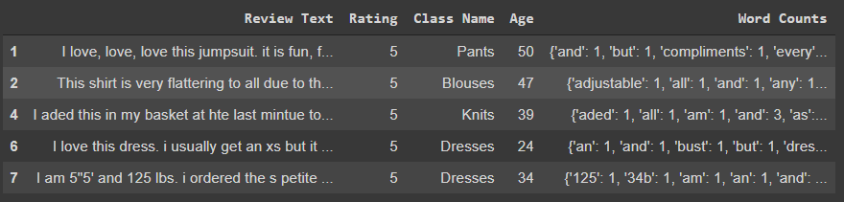
Filtration using Ratings
that only contains 5-star and 1-star reviews

Slide 6
Splitted the Data on REVIEW AND RATING
split our dataset in train (80%) and test (20%) set.
This is crucial for the robustness of our model: indeed, since the main goal of any machine learning model is making an accurate prediction on new, never-seen-before data, it is pivotal to tune the parameters of our algorithm based on its performance on the test set rather than on the train set, in order to avoid overfitting.
As you can see, we ended up with a model with an accuracy of 94.25%, which is very good to be an indicator of a reliable predictor. This is how I Predicted the ratings collected by users as reviews.

Slide 7

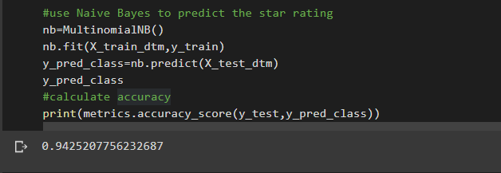
Naïve Bayes Model TO Predict Star Rating

Slide 8
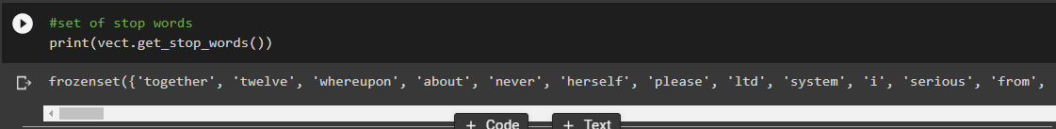
Stop Words Removal
Stopwords are the English words which does not add much meaning to a sentence. They can safely be ignored without sacrificing the meaning of the sentence. For example, the words like the, he, have etc. Such words are already captured this in corpus named corpus.

Slide 9
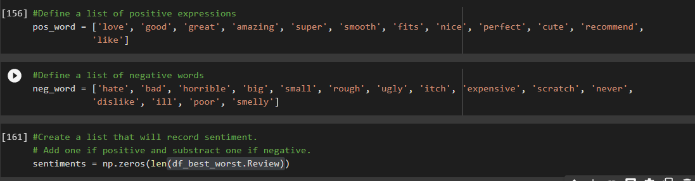
Sentiment Analysis
Sentiment Analysis (also known as opinion mining or emotion AI) is a sub-field of NLP that tries to identify and extract opinions within a given text across blogs, reviews, social media, forums, news etc

Slide 10

Conclusion
When we look at the results of the all evaluation metrics in the evaluating models section, Naive Bayes and Logistic Regression gives the best results for our analysis. Thus, both of them are very effective at predicting sentiment.
On the other hand, it seems that Naive Bayes takes less time and when we have a bigger dataset, this difference might increase and be an important advantage .

